Slide 1
Least Squares Data-fitting
S. J. Hahn

Slide 2
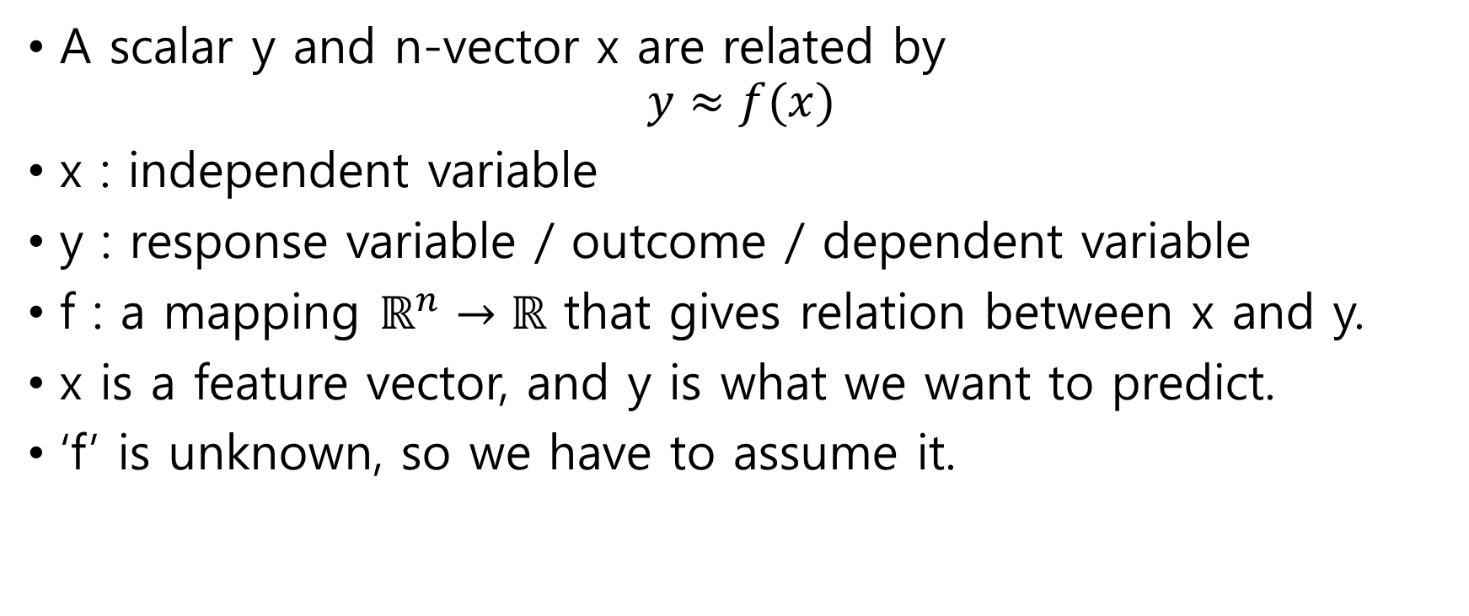
Regression
A scalar y and n-vector x are related by
$$y≈f(x)$$
x : independent variable
y : response variable / outcome / dependent variable
f : a mapping $ℝ^{n}→ℝ$ that gives relation between x and y.
x is a feature vector, and y is what we want to predict.
‘f’ is unknown, so we have to assume it.

Slide 3
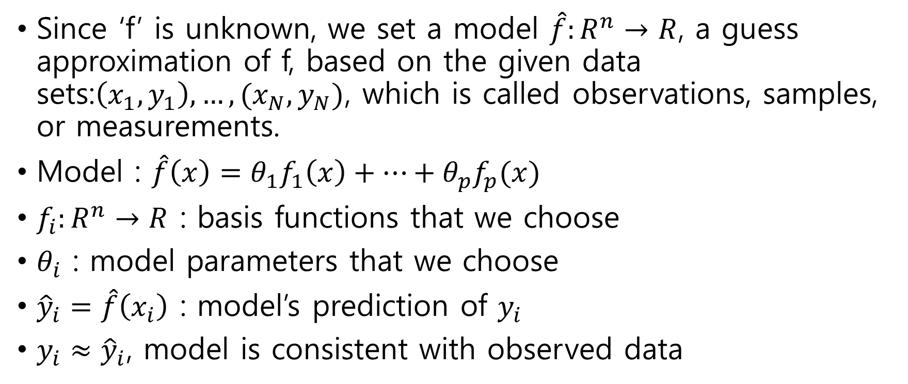
Modeling
Since ‘f’ is unknown, we set a model $\hat{f}:R^{n}→R$, a guess approximation of f, based on the given data sets:$\left(x_{1},y_{1}\right), …,(x_{N},y_{N})$, which is called observations, samples, or measurements.
Model : $\hat{f}\left(x\right)=θ_{1}f_{1}\left(x\right)+…+θ_{p}f_{p}(x)$
$f_{i}:R^{n}→R$ : basis functions that we choose
$θ_{i}$ : model parameters that we choose
${\hat{y}}_{i}=\hat{f}\left(x_{i}\right)$ : model’s prediction of $y_{i}$
$y_{i}≈{\hat{y}}_{i}$, model is consistent with observed data

Slide 4
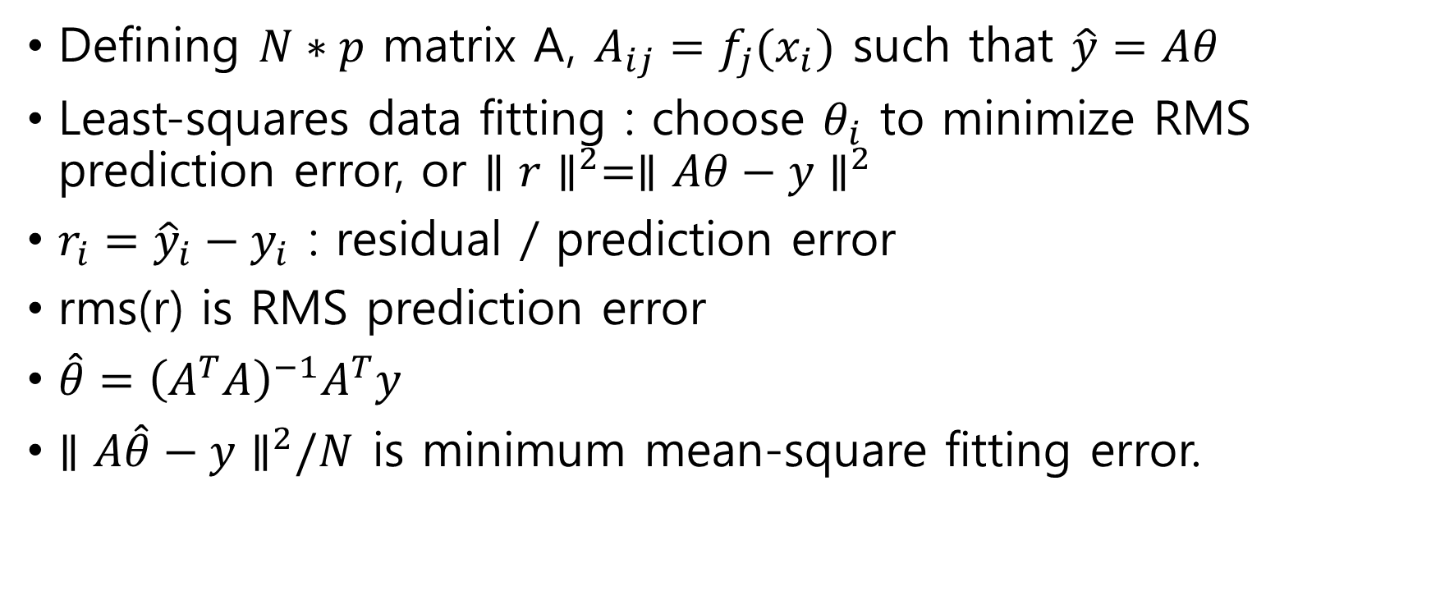
Least-squares data fitting
Defining $N∗p$ matrix A, $A_{ij}=f_{j}(x_{i})$ such that $\hat{y}=Aθ$
Least-squares data fitting : choose $θ_{i}$ to minimize RMS prediction error, or $∥r∥^{2}=∥Aθ−y∥^{2}$
$r_{i}={\hat{y}}_{i}−y_{i}$ : residual / prediction error
rms(r) is RMS prediction error
$\hat{θ}={\left(A^{T}A\right)}^{−1}A^{T}y$
$∥A\hat{θ}−y∥^{2}/N$ is minimum mean-square fitting error.

Slide 5
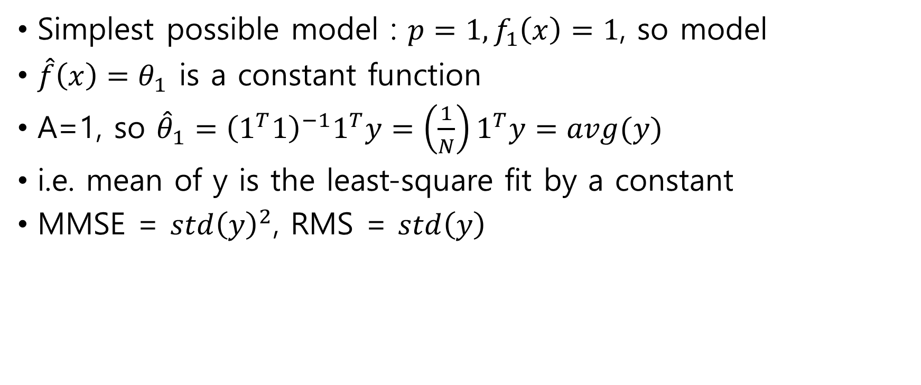
Fitting a constant model
Simplest possible model : $p=1, f_{1}\left(x\right)=1$, so model
$\hat{f}\left(x\right)=θ_{1}$ is a constant function
A=1, so ${\hat{θ}}_{1}={\left(1^{T}1\right)}^{−1}1^{T}y=\left(\frac{1}{N}\right)1^{T}y=avg(y)$
i.e. mean of y is the least-square fit by a constant
MMSE = $std{\left(y\right)}^{2}$, RMS = $std\left(y\right)$

Slide 6

Straight-line fitting
Condition : p=2, with $f_{1}\left(x\right)=1, f_{2}\left(x\right)=x$
Model : $\hat{f}\left(x\right)=θ_{1}+θ_{2}x$
Matrix A has a form

Slide 7
Straight-line fitting
Condition : p=2, with $f_{1}\left(x\right)=1, f_{2}\left(x\right)=x$
Model : $\hat{f}\left(x\right)=θ_{1}+θ_{2}x$
Matrix A has a form

Slide 8
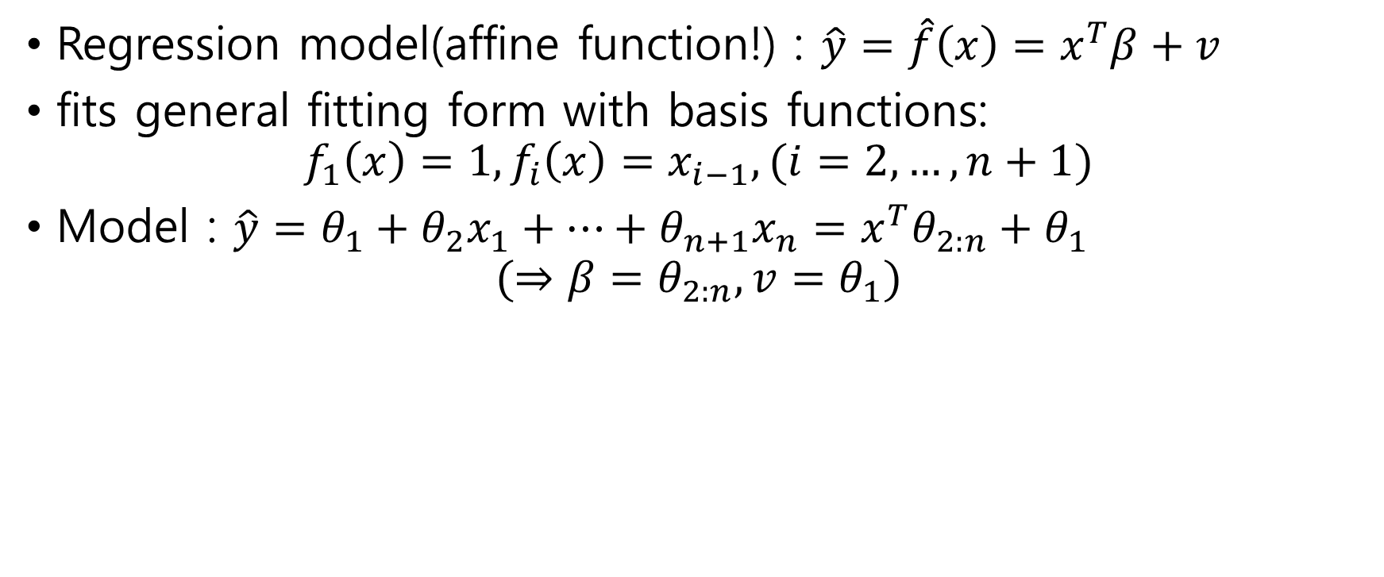
Regression as general data fitting
Regression model(affine function!) : $\hat{y}=\hat{f}\left(x\right)=x^{T}β+v$
fits general fitting form with basis functions:
$$f_{1}\left(x\right)=1, f_{i}\left(x\right)=x_{i−1}, (i=2,…,n+1)$$
Model : $\hat{y}=θ_{1}+θ_{2}x_{1}+…+θ_{n+1}x_{n}=x^{T}θ_{2:n}+θ_{1}$
$$(⇒β=θ_{2:n},v=θ_{1})$$

Slide 9
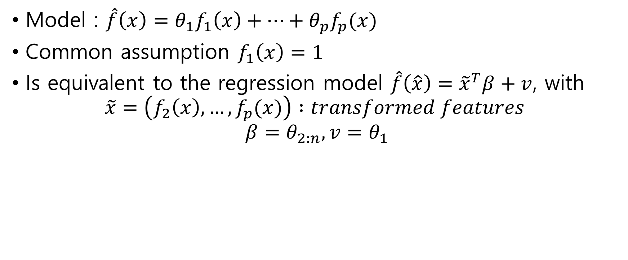
General data fitting as regression
Model : $\hat{f}\left(x\right)=θ_{1}f_{1}\left(x\right)+…+θ_{p}f_{p}(x)$
Common assumption $f_{1}\left(x\right)=1$
Is equivalent to the regression model $\hat{f}\left(\hat{x}\right)={\tilde{x}}^{T}β+v$, with
$$\tilde{x}=\left(f_{2}\left(x\right), …, f_{p}(x)\right) :transformed features$$
$$β=θ_{2:n},v=θ_{1}$$

Slide 10
Generalization
Goal of the model : predict the outcome of new, unseen data, not given data.
Generalization ability : a model having an ability to make reasonable predictions on new, unseen data.
Over-fit : a model making poor predictions on new, unseen data.

Slide 11
Validation
To check whether the model can be generalized or not.
Split original data into training data and validation data(test data) (typically 8:2 or 9:1)
Building a model on training data set
Check the model’s performance on the test data set (comparing RMS prediction error on train and test data)
If they are similar, we can guess the model will generalize.
Can be used to choose among different model candidates.
Choose one with lowest test error.

Slide 12
Validation Example : Polynomial fit
Using N=100 points
Using new points,
Degree between 4 and 7 are reasonable

Slide 13
Cross Validation
By dividing data into 10 folds, building a model using all folds except i (for i = 1, 2, … , 10), and then test the model on data in fold i.
If the test RMS errors are much larger than train RMS errors, model is over-fit
If the test RMS errors and train RMS errors are similar and consistent, we can guess the model will have a similar RMS error on future data.

Slide 14
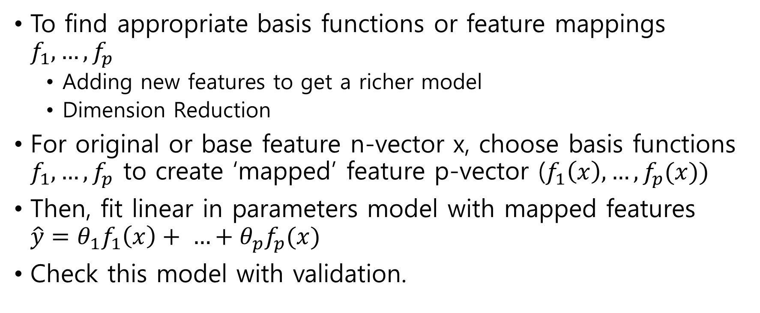
Feature Engineering
To find appropriate basis functions or feature mappings $f_{1}, …, f_{p}$
$\text{Adding} \text{new} \text{features} \text{to} \text{get} \text{a} \text{richer} \text{model}$
$\text{Dimension} \text{Reduction}$
For original or base feature n-vector x, choose basis functions $f_{1}, …, f_{p}$ to create ‘mapped’ feature p-vector ($f_{1}\left(x\right), …, f_{p}(x))$
Then, fit linear in parameters model with mapped features $\hat{y}=θ_{1}f_{1}\left(x\right)+ …+θ_{p}f_{p}(x)$
Check this model with validation.

Slide 15
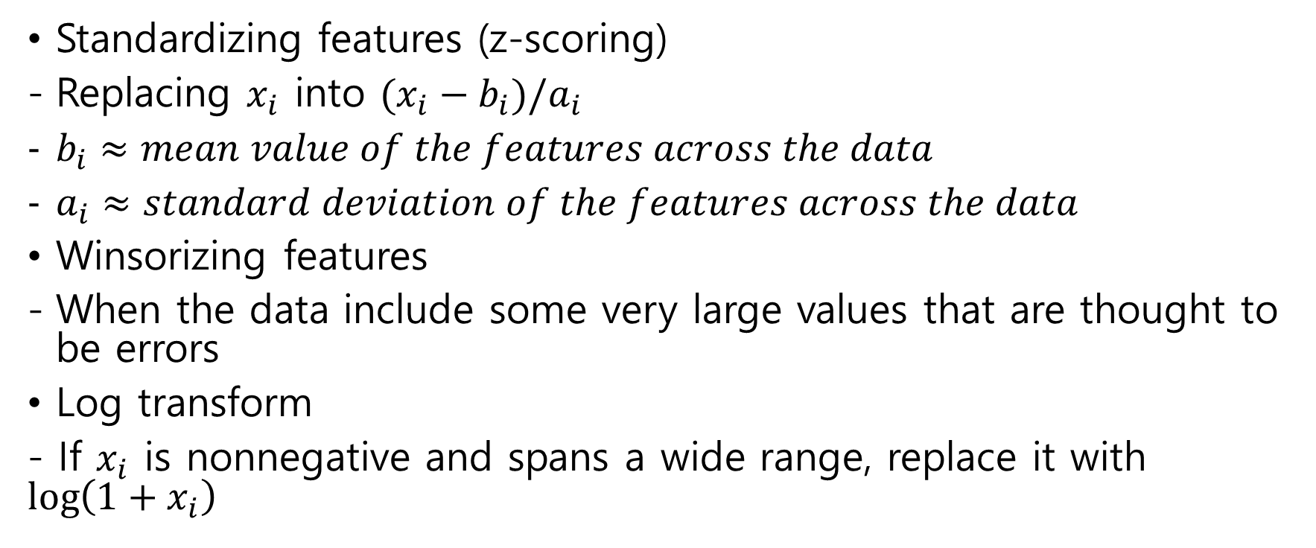
Transforming Features
Standardizing features (z-scoring)
Replacing $x_{i}$ into $(x_{i}−b_{i})/a_{i}$
$b_{i}≈mean value of the features across the data$
$a_{i}≈standard deviation of the features across the data$
Winsorizing features
When the data include some very large values that are thought to be errors
Log transform
- If $x_{i}$ is nonnegative and spans a wide range, replace it with $\log\left(1+x_{i}\right)$

